Slide 1
CA 7503 Software Testing

Slide 2
Lecture 7 : Testing the Software with Blinders On

Slide 3
Today we are discuss on..
What is dynamic black-box testing?
How to reduce the number of test cases by equivalence partitioning?
How to identify troublesome boundary conditions?
Good data values to use to induce bugs
How to test software states and state transitions?
How to use repetition, stress, and high loads to locate bugs?

Slide 4
Dynamic Black-Box Testing
Testing software without having an insight into the details of underlying code is dynamic black-box testing.
It’s dynamic because the program is running—you’re using it as a customer would. And, it’s black-box because you’re testing it without knowing exactly how it works - with blinders on.
You’re entering inputs, receiving outputs, and checking the results.
Another name commonly used for dynamic black-box testing is behavioral testing because you’re testing how the software actually behaves when it’s used.
Once you know the ins and outs of the software you’re about to test, your next step is to start defining the test cases.

Slide 5
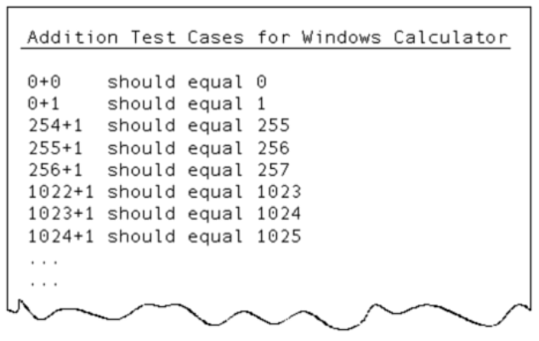
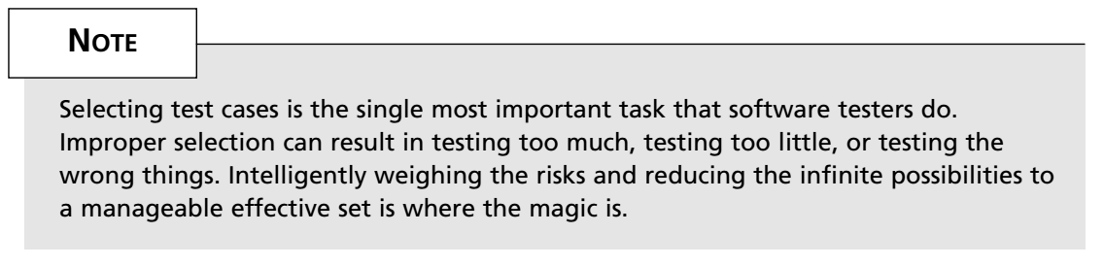
Dynamic Black-Box Testing

Slide 6
Test-to-Pass and Test-to-Fail
There are two fundamental approaches to testing software: test-to-pass and test-to-fail.
When you test-to-pass, you really assure only that the software minimally works. You don’t push its capabilities. You don’t see what you can do to break it. You treat it with kid gloves, applying the simplest and most straight forward test cases.
Think about an analogy with a newly designed car (see Figure). You’re assigned to test the very first prototype that has just rolled off the assembly line and has never been driven.

Slide 7
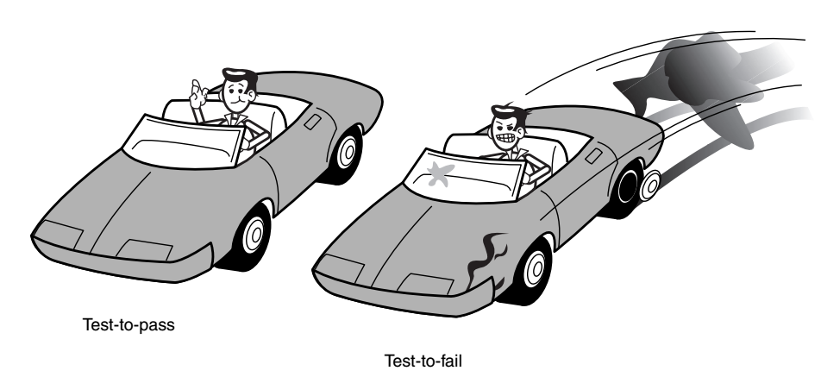
Test-to-Pass and Test-to-Fail

Slide 8
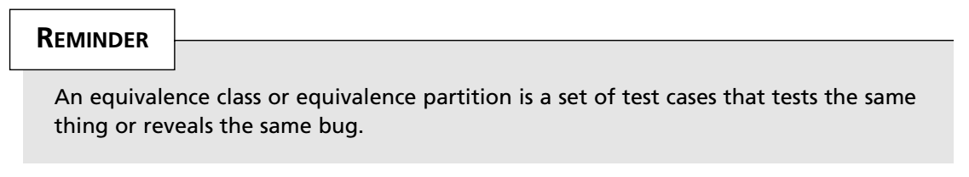
Equivalence Partitioning
Selecting test cases is the single most important task that software testers do and equivalence partitioning, sometimes called equivalence classing, is the means by which they do it.
Equivalence partitioning is the process of methodically reducing the huge (infinite) set of possible test cases into a much smaller, but still equally effective, set.

Slide 9
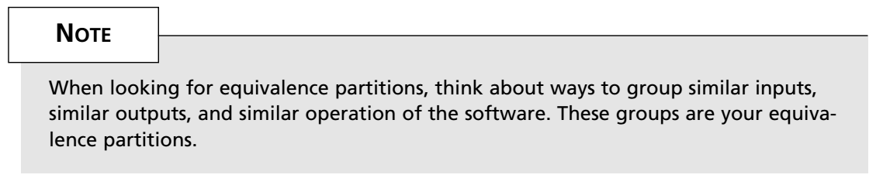
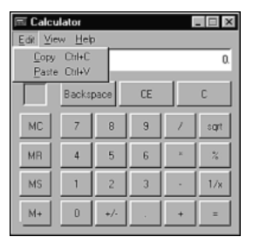
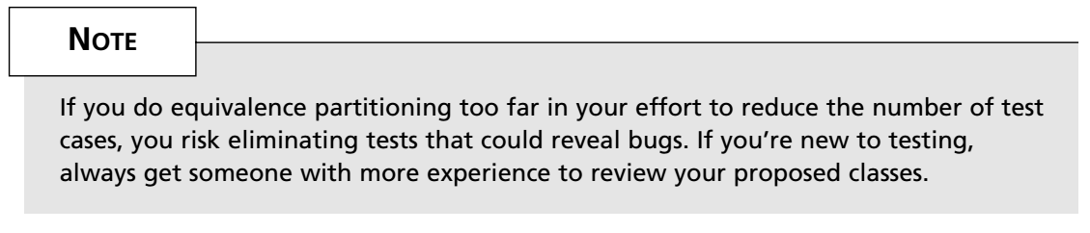
Equivalence Partitioning
For copy, you click the Copy menu item, type c or C, or press Ctrl+c or Ctrl+Shift+c.
If your job is to test the copy command, you could partition these five input paths down to three: Clicking the command on the menu, typing a c, or pressing Ctrl+c.

Slide 10
Data Testing
The simplest view of software is to divide it into two parts: the data (or its domain) and the program.
The data is the keyboard input, mouse clicks, disk files, printouts, and so on.
The program is the executable flow, transitions, logic, and computations.
Examples of data would be
The words you type into a word processor
The numbers entered into a spreadsheet
The number of shots you have remaining in your space game
The picture printed by your photo software
The backup files stored on your floppy disk
The data being sent by your modem over the phone lines

Slide 11
Data Testing
The trick (if you can call it that) to making any of these testable is to intelligently reduce the test cases by equivalence partitioning based on a few key concepts: boundary conditions, sub-boundary conditions, nulls, and bad data.

Slide 12
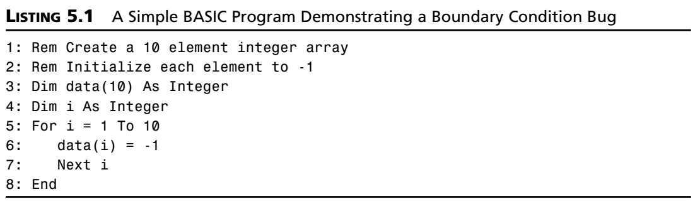
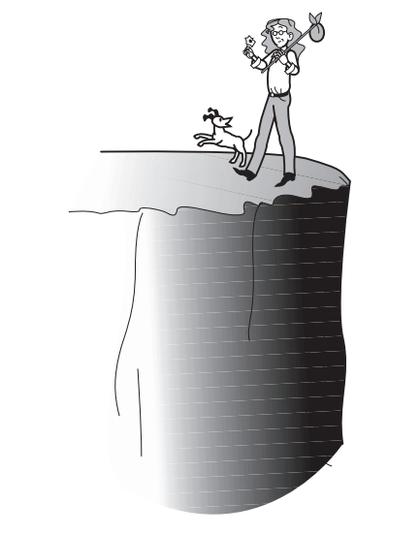
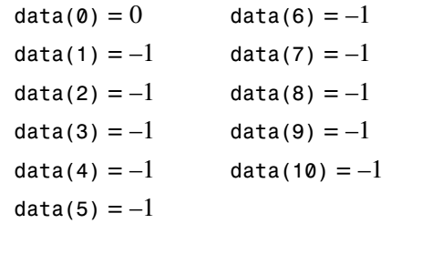
Boundary Conditions
Boundary conditions are special because programming, by its nature, is susceptible to problems at its edges.
This program actually creates a data array of 11 elements from data(0) to data(10).The program loops from 1 to 10 and initializes those values of the array to –1, but since the first element of our array is data(0),it doesn’t get initialized. When the program completes, the array values look like this:
Problems such as this are very common and, in large complex software, can result in very nasty bugs.

Slide 13
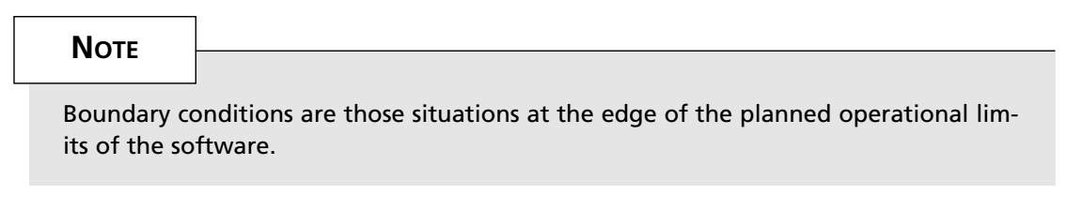
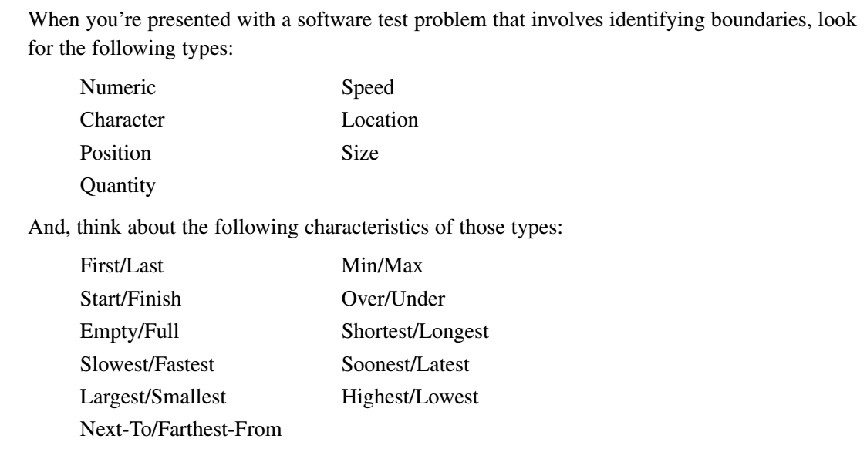
Types of Boundary Conditions

Slide 14
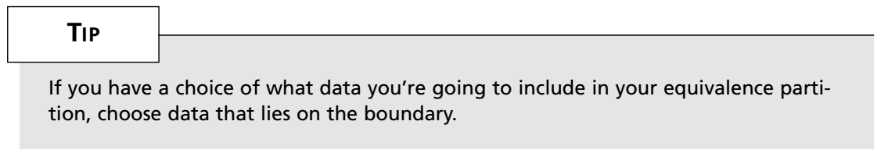
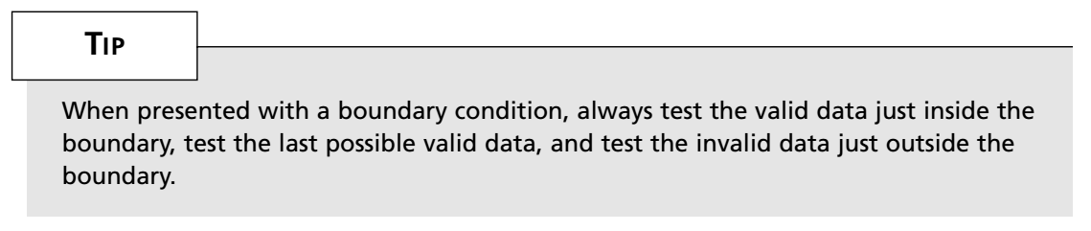
Types of Boundary Conditions
Testing the Boundary Edges

Slide 15
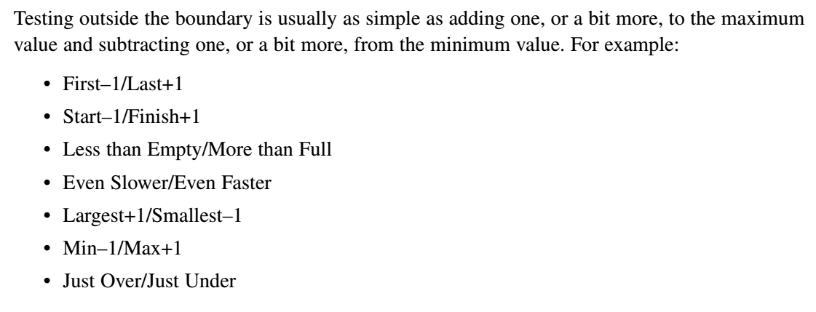
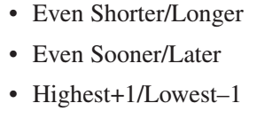
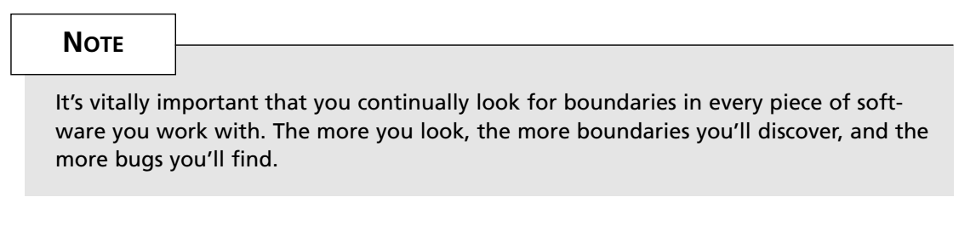
Testing the Boundary Edges

Slide 16
Sub-Boundary Conditions
The normal boundary conditions just discussed are the most obvious to find. They’re the ones defined in the specification or evident when using the software. Some boundaries, though, that are internal to the software aren’t necessarily apparent to an end user but still need to be checked by the software tester. These are known as sub-boundary conditions or internal boundary conditions.

Slide 17
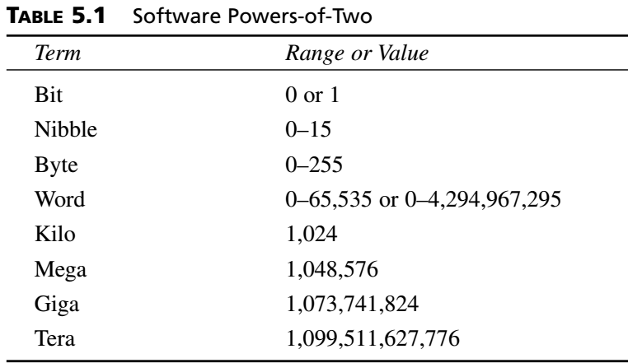
Sub-Boundary Conditions
These boundaries don’t require that you be a programmer or that you be able to read the raw code that you’re testing, but they do require a bit of general knowledge about how software works. Two examples are powers-of-two and the ASCII table.
The ranges and values shown in Table 5.1 are critical values to treat as boundary conditions.

Slide 18
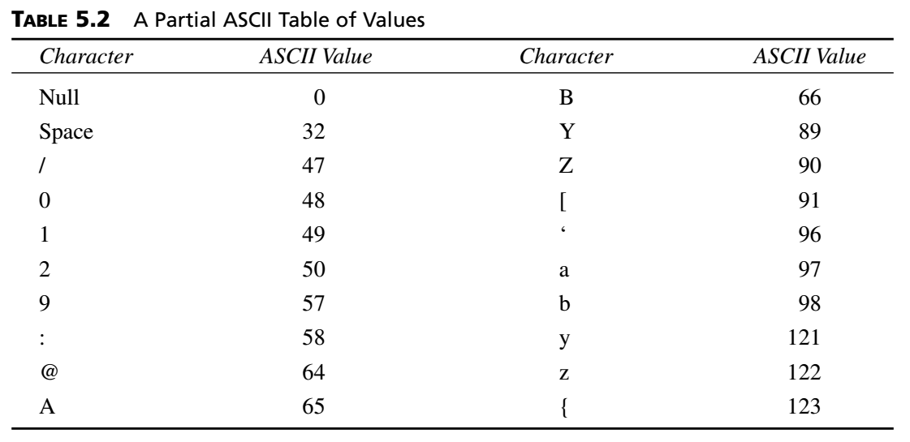
Sub-Boundary Conditions
For example, if you are testing a text box that accepts only the characters A–Z and a–z, you should include in your invalid partition the values just below and above those in the ASCII table—@, [, ‘, and {.

Slide 19
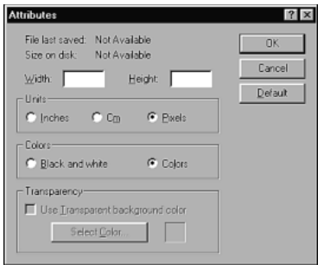
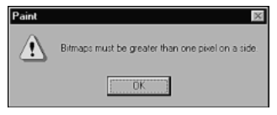
Default, Empty, Blank, Null, Zero, and None
Another source of bugs that may seem obvious is when the software requests an entry—say, in a text box—but rather than type the correct information, the user types nothing. He may just press Enter. This situation is often overlooked in the specification or forgotten by the programmer but is a case that typically happens in real life.

Slide 20
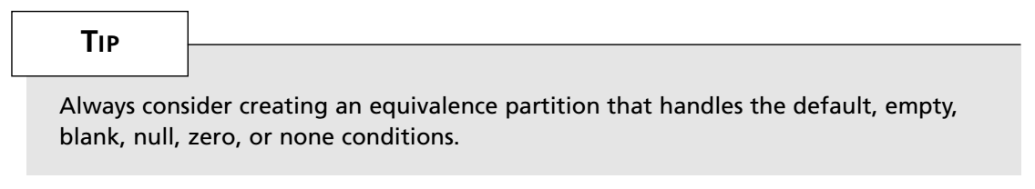
Default, Empty, Blank, Null, Zero, and None
You should create a separate equivalence partition for these values rather than lump them into the valid cases or the invalid cases because the software usually handles them differently. It’s likely that in this default case, a different software path is followed than if the user typed 0 or –1 as invalid values. Since you expect different operation of the software, they should be in their own partition.

Slide 21
Invalid, Wrong, Incorrect, and Garbage Data
The final type of data testing is garbage data. This is where you test-to-fail.
Software testing purists might argue that this isn’t necessary, that if you’ve tested everything discussed so far you’ve proven the software will work. In the real word, however, there’s nothing wrong with seeing if the software will handle whatever a user can do to it.
So, with invalid, wrong, incorrect, and garbage data testing, have some fun. If the software wants numbers, give it letters. If it accepts only positive numbers, enter negative numbers. If it’s date sensitive, see if it’ll work correctly on the year 3000.
There are no real rules for this testing other than to try to break the software.

Slide 22
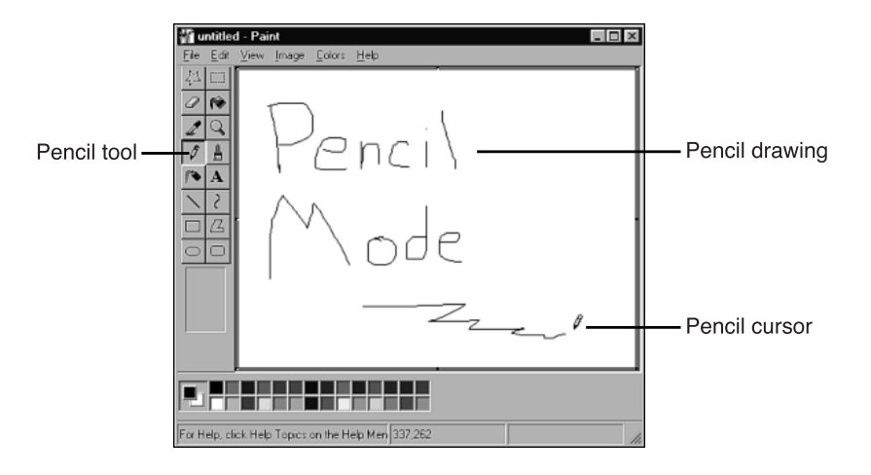
State Testing
A software state is a condition or mode that the software is currently in.

Slide 23
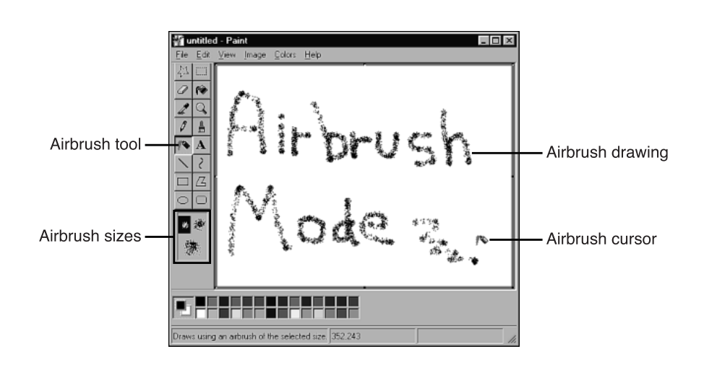
State Testing

Slide 24
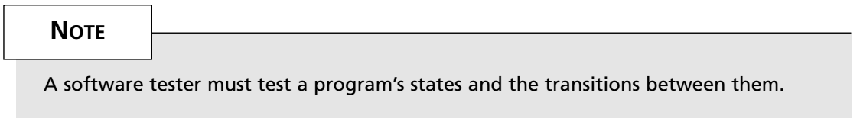
State Testing
Whenever you select one of these and make the software change its look, its menus, or its operation, you’re changing its state. The software follows a path through the code, toggles some bits, sets some variables, loads some data, and arrives at a new state of being.

Slide 25
Testing the Software’s Logic Flow
Testing the software’s states and logic flow has the same problems. It’s usually possible to visit all the states. The difficulty is that except for the simplest programs, it’s often impossible to traverse all paths to all states.
The problem is similar to the well-known traveling salesman problem:
If there were only five cities, you could do some quick math and discover that there are 120 different routes. Traversing each of them and finding the shortest route to all wouldn’t be that difficult or take that much time.

Slide 26
Testing the Software’s Logic Flow
The solution for software testing is to apply equivalence partition techniques to the selection of the states and paths, assuming some risk because you will choose not to test all of them, but reducing that risk by making intelligent choices.

Slide 27
Creating a State Transition Map
The first step is to create your own state transition map of the software. Such a map may be provided as part of the product specification.
There are several different diagramming techniques for state transition diagrams.
One uses boxes and arrows and the other uses circles (bubbles) and arrows.

Slide 28
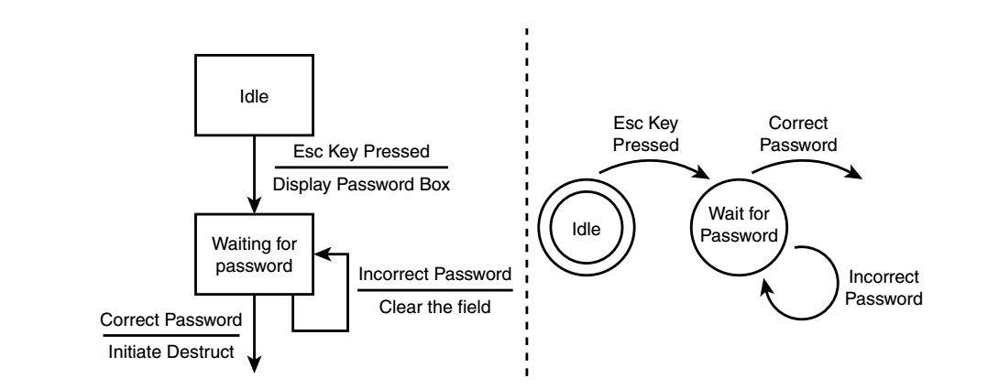
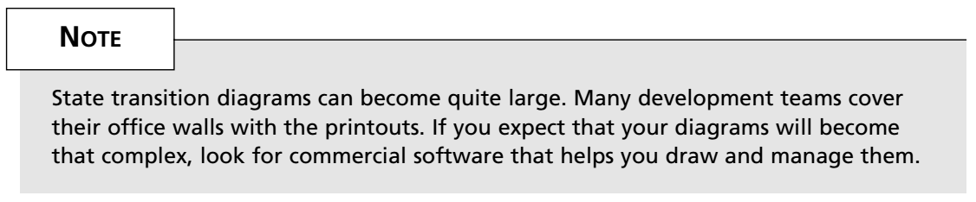
Creating a State Transition Map

Slide 29
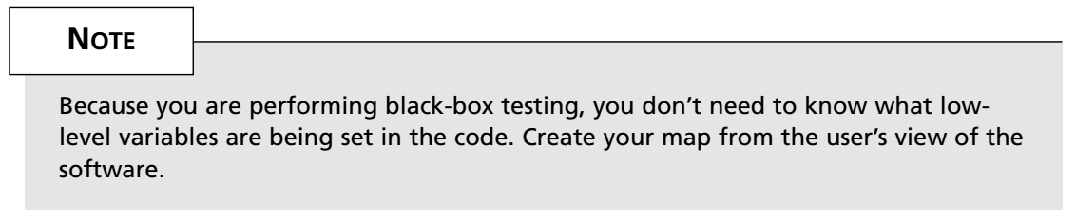
Creating a State Transition Map
A state transition map should show the following items:
Each unique state that the software can be in.
The input or condition that takes it from one state to the next.
Set conditions and produced output when a state is entered or exited.

Slide 30
Reducing the Number of States and Transitions to Test
Creating a map for a large software product is a huge undertaking. Hopefully, you’ll be testing only a portion of the overall software so that making the map is a more reasonable task.
Just as you learned with equivalence partitioning for data, you need to reduce the huge set of possibilities to a set of test cases of workable size. There are five ways to do this:
Visit each state at least once.
Test the state-to-state transitions that look like the most common or popular.
Test the least common paths between states.
Test all the error states and returning from the error states.
Many times error conditions are difficult to create.
Test random state transitions.

Slide 31
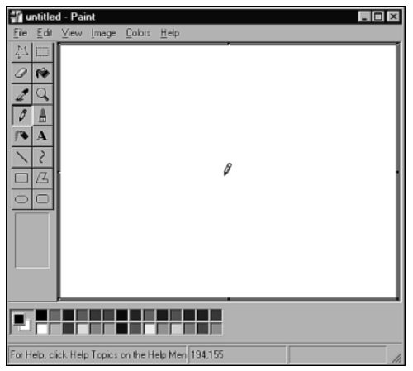
What to Specifically Test?
After you identify the specific states and state transitions that you want to test, you can begin defining your test cases.
Testing states and state transitions involves checking all the state variables - the static conditions, information, values, functionality, and so on that are associated with being in that state or moving to and from that state.
Here’s a partial list of the state variables that define Paint’s startup state: • The window looks as shown in Figure. • The window size is set to what it was the last time Paint was used. • The drawing area is blank. • The tool box, color box, and status bar are displayed. • The pencil tool is selected. All the others are not. • The default colors are black foreground on a white background. • The document name is untitled.

Slide 32
Testing States to Fail
Everything discussed so far regarding state testing has been about testing-to-pass.
The flip side to this, just as in data testing, is to find test cases that test the software to fail.
Examples of such cases are race conditions, repetition, stress, and load.

Slide 33
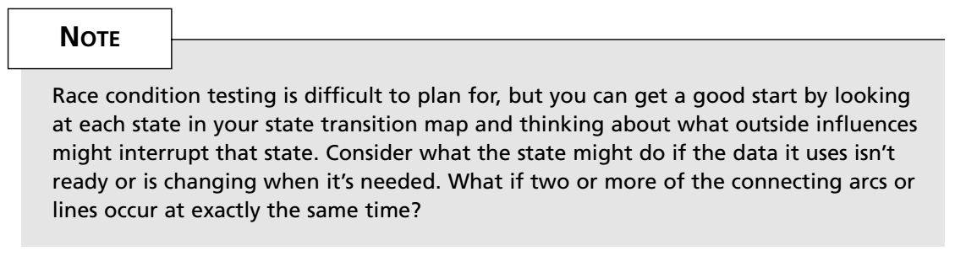
Race Conditions and Bad Timing
Multitasking means that an operating system is designed to run separate processes concurrently.
In a truly multitasking environment, the software can’t take anything for granted.
The term race condition comes from just what you’d think—multiple processes racing to a finish line, not knowing which will get there first.

Slide 34
Race Conditions and Bad Timing
Here are a few examples of situations that might expose race conditions:
Saving and loading the same document at the same time with two different programs
Sharing the same printer, communications port, or other peripheral
Pressing keys or sending mouse clicks while the software is loading or changing states
Shutting down or starting up two or more instances of the software at the same time
Using different programs to simultaneously access a common database

Slide 35
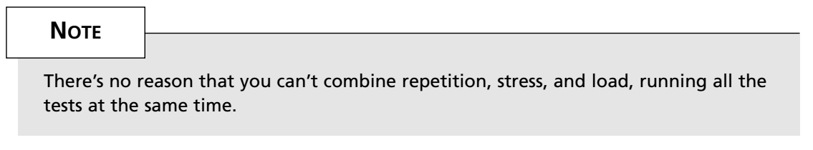
Repetition, Stress, and Load
Three other test-to-fail state tests are repetition, stress, and load. These tests target state handling problems where the programmer didn’t consider what might happen in the worst-case scenarios.
Repetition testing involves doing the same operation over and over. This could be as simple as starting up and shutting down the program over and over.
Stress testing is running the software under less-than-ideal conditions—low memory, low disk space, slow CPUs, slow modems, and so on.
Load testing is the opposite of stress testing. With stress testing, you starve the software; with load testing, you feed it all that it can handle.

Slide 36
Repetition, Stress, and Load
There are two important considerations with repetition, stress, and load testing:
Your team’s programmers and project managers may not be completely receptive to your efforts to break the software this way. You’ll probably hear them complain that no customer will use the system this way or stress it to the point that you are.
Opening and closing your program a million times is probably not possible if you’re doing it by hand. Likewise, finding a few thousand people to connect to your Internet server might be difficult to organize.

